Slide 1
Violent Extremist Organization Classification in Afghanistan, Using Machine Learning
Stephen Davanzo
DATS 6501, Prof. Amir Jafari

Slide 2


Problem Statement
This project develops supervised machine learning models to classify unattributed or ambiguously attributed violent events in Afghanistan between Taliban or ISIS-K using ACLED data from 2017–2021.

Slide 3
Project Goals
Inform qualitative analysis with ML enabled feature importance testing.
Test the feasibility of classifying attacks based on threat tactics/description (no spatial features).
Deploy UI to assist in easy classification attacks

Slide 4

Data
ACLED (Armed Conflict Location & Event Data) serves to collect data on violent conflict and protest in all countries and territories in the world.
Whether the attacks targeted civilians
The number of fatalities recorded
The type of attack tactic
The type of weapons used in a given attack
The country of attack
Unstructured text describing the event
Notes:
eva

Slide 5
Data Preprocessing
Group name and location removal
REGEX to strip names and location
Create 23 domain specific features
Examples..
fatalities - discrete
civilian_targeting - binary flag
Attack type (class/suicide bomb/IED) - one hot encode
Sentence-Transformer for 384-dimensional semantic embeddings

Slide 6
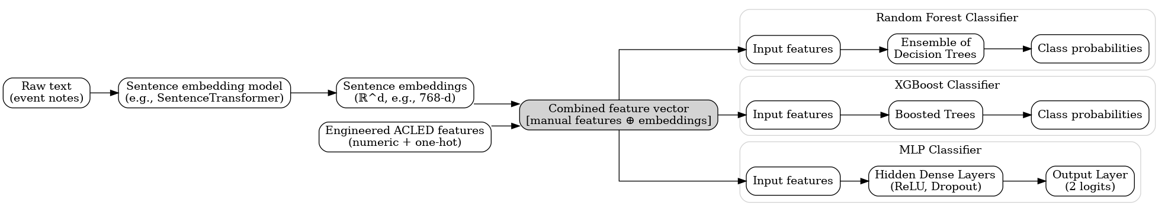
Methods: Classical
Seven resampling stargetics tested: SMOTE, ADASYN, BorderlineSMOTE, SVM-SMOTE, RandomOverSampler, SMOTE-ENN, and SMOTE-Tomek
Custom grid-search-like function for hyperparameter choice

Slide 7
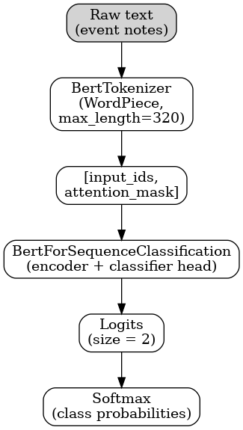
Methods: BERT
Focal Loss (α=0.65, γ=2.0): Down-weights loss from easily classified majority
Batch Balancing: Each training batch contains equal numbers of Taliban and ISIS-K examples through WeightedRandomSampler, preventing long runs of majority-class gradients

Slide 8
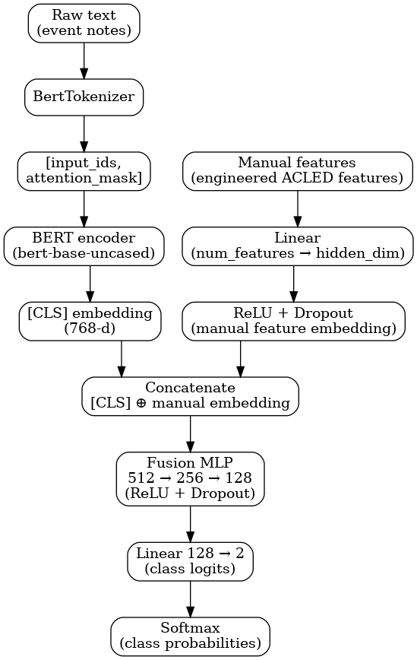
Methods: Fusion
BERT Embeddings: Event description processed through fine-tuned BERT to generate 768-dimensional [CLS] token representation
Feature Processing: The 23 manual features pass through a dense layer (23 → 128 dimensions) with ReLU activation
Intelligent Fusion: Concatenated representations [768 + 128 = 896] feed into fusion layers [256 → 128 → 2] with batch normalization and dropout (0.3)

Slide 9
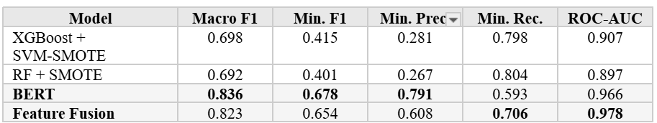
Results
The models demonstrate a fundamental precision-recall trade-off. Classical models achieve highest recall (79.8%) but lowest precision (28.1%), meaning they catch most ISIS-K attacks but generate many false alarms. BERT provides the best balance with 79.1% precision and 64.7% recall. Feature fusion offers a middle ground with 19% higher recall than BERT while maintaining reasonable precision.

Slide 10
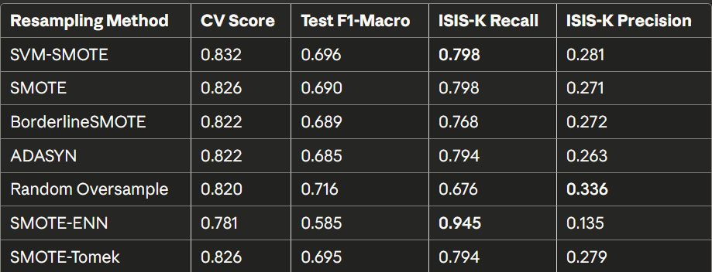
Results: Classical Models
SVM-SMOTE consistently outperforms other resampling methods
Best classical: XGBoost + SVM-SMOTE (macro F1 = 0.485)
Still substantially underperforms transformers
SVM-SMOTE generates synthetic samples at decision boundaries

Slide 11
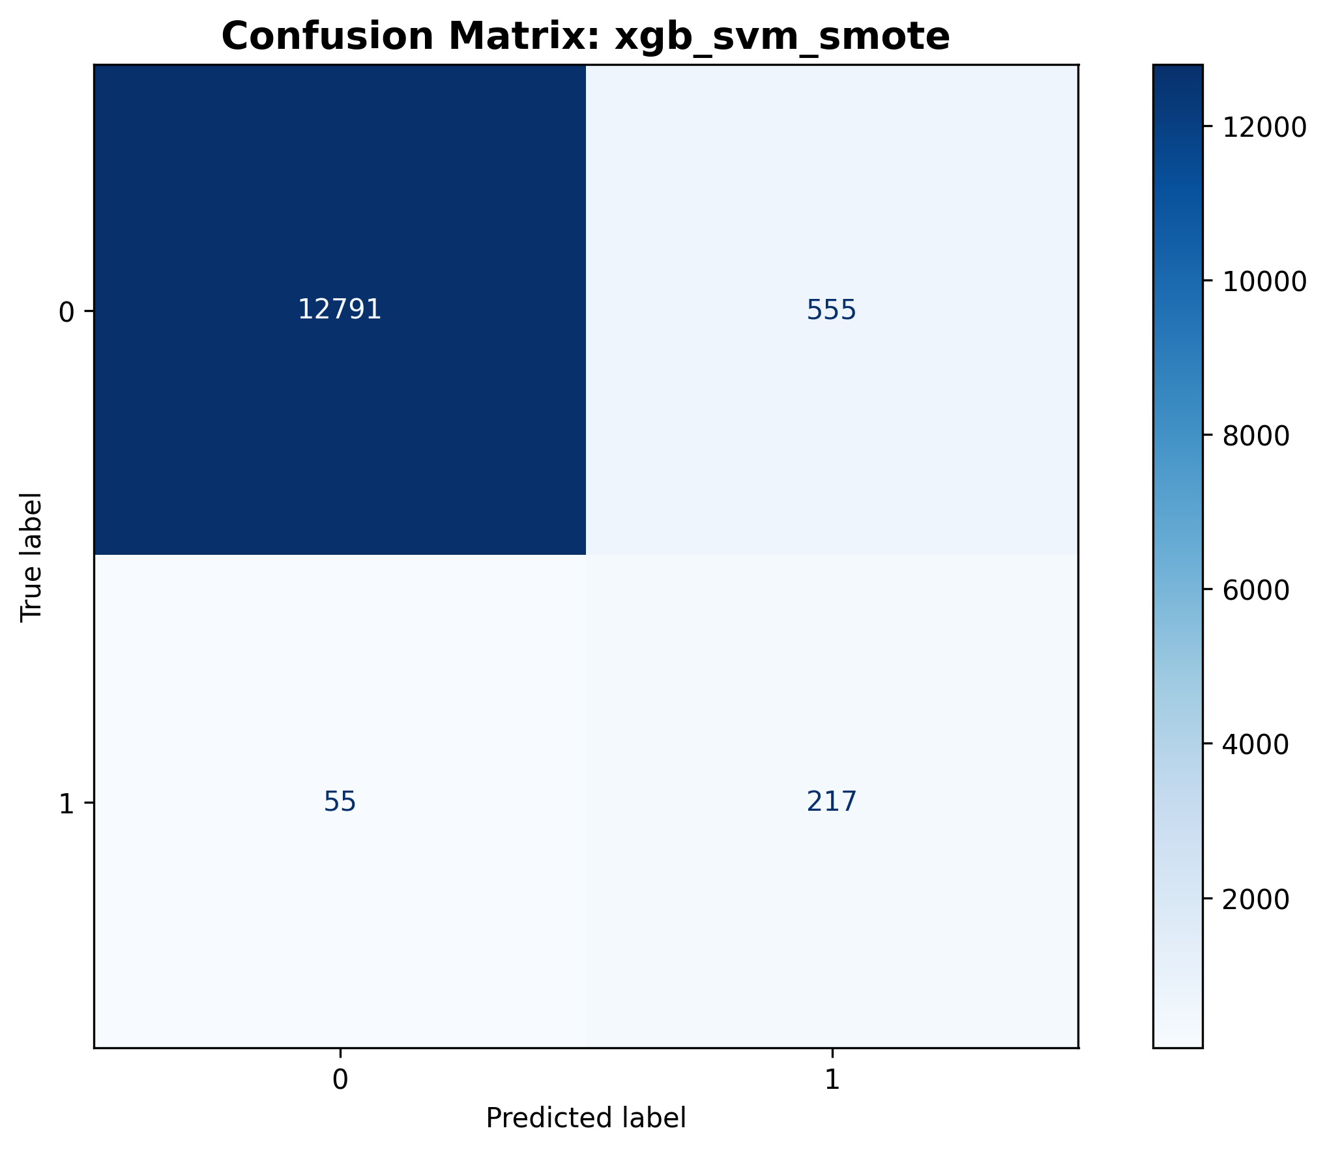
Results: Classical Models
XGBoost achieves highest recall: 79.8% (163 of 204 ISIS-K detected)
Cost: very low precision 28.1% (72% false positives)
Good for initial screening where missing attacks is costly
Requires subsequent verification before action

Slide 12
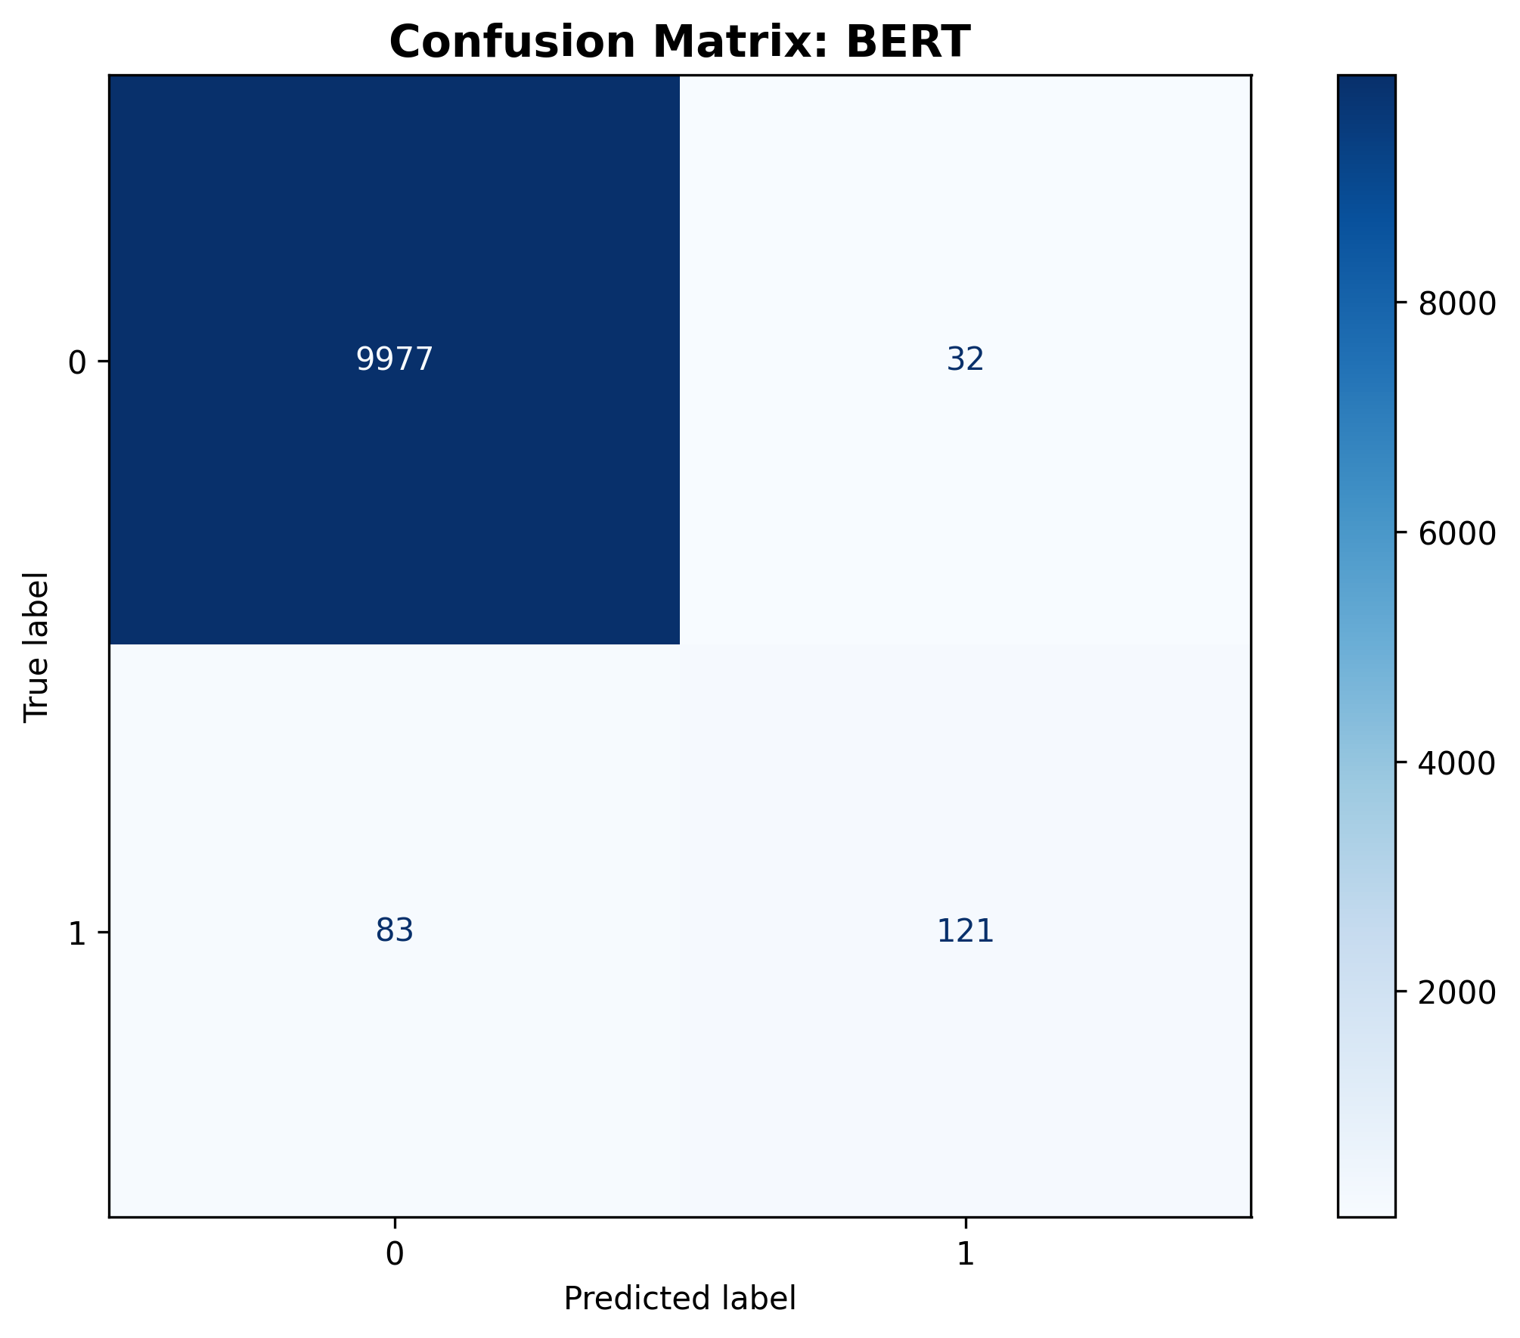
Results: BERT

Slide 13
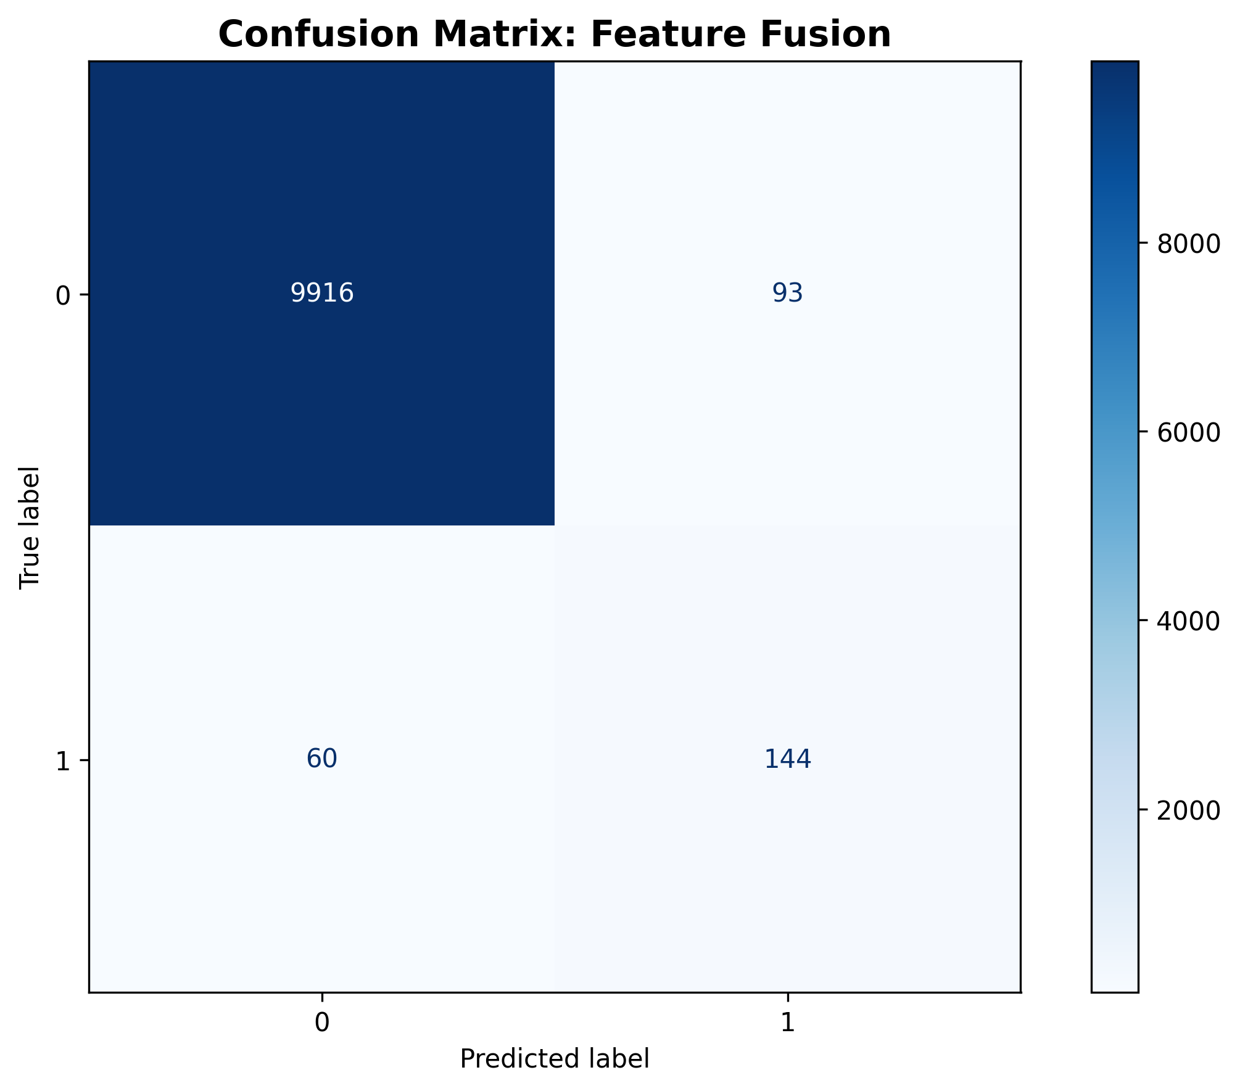
Results: Feature Fusion

Slide 14
XAI

Slide 15
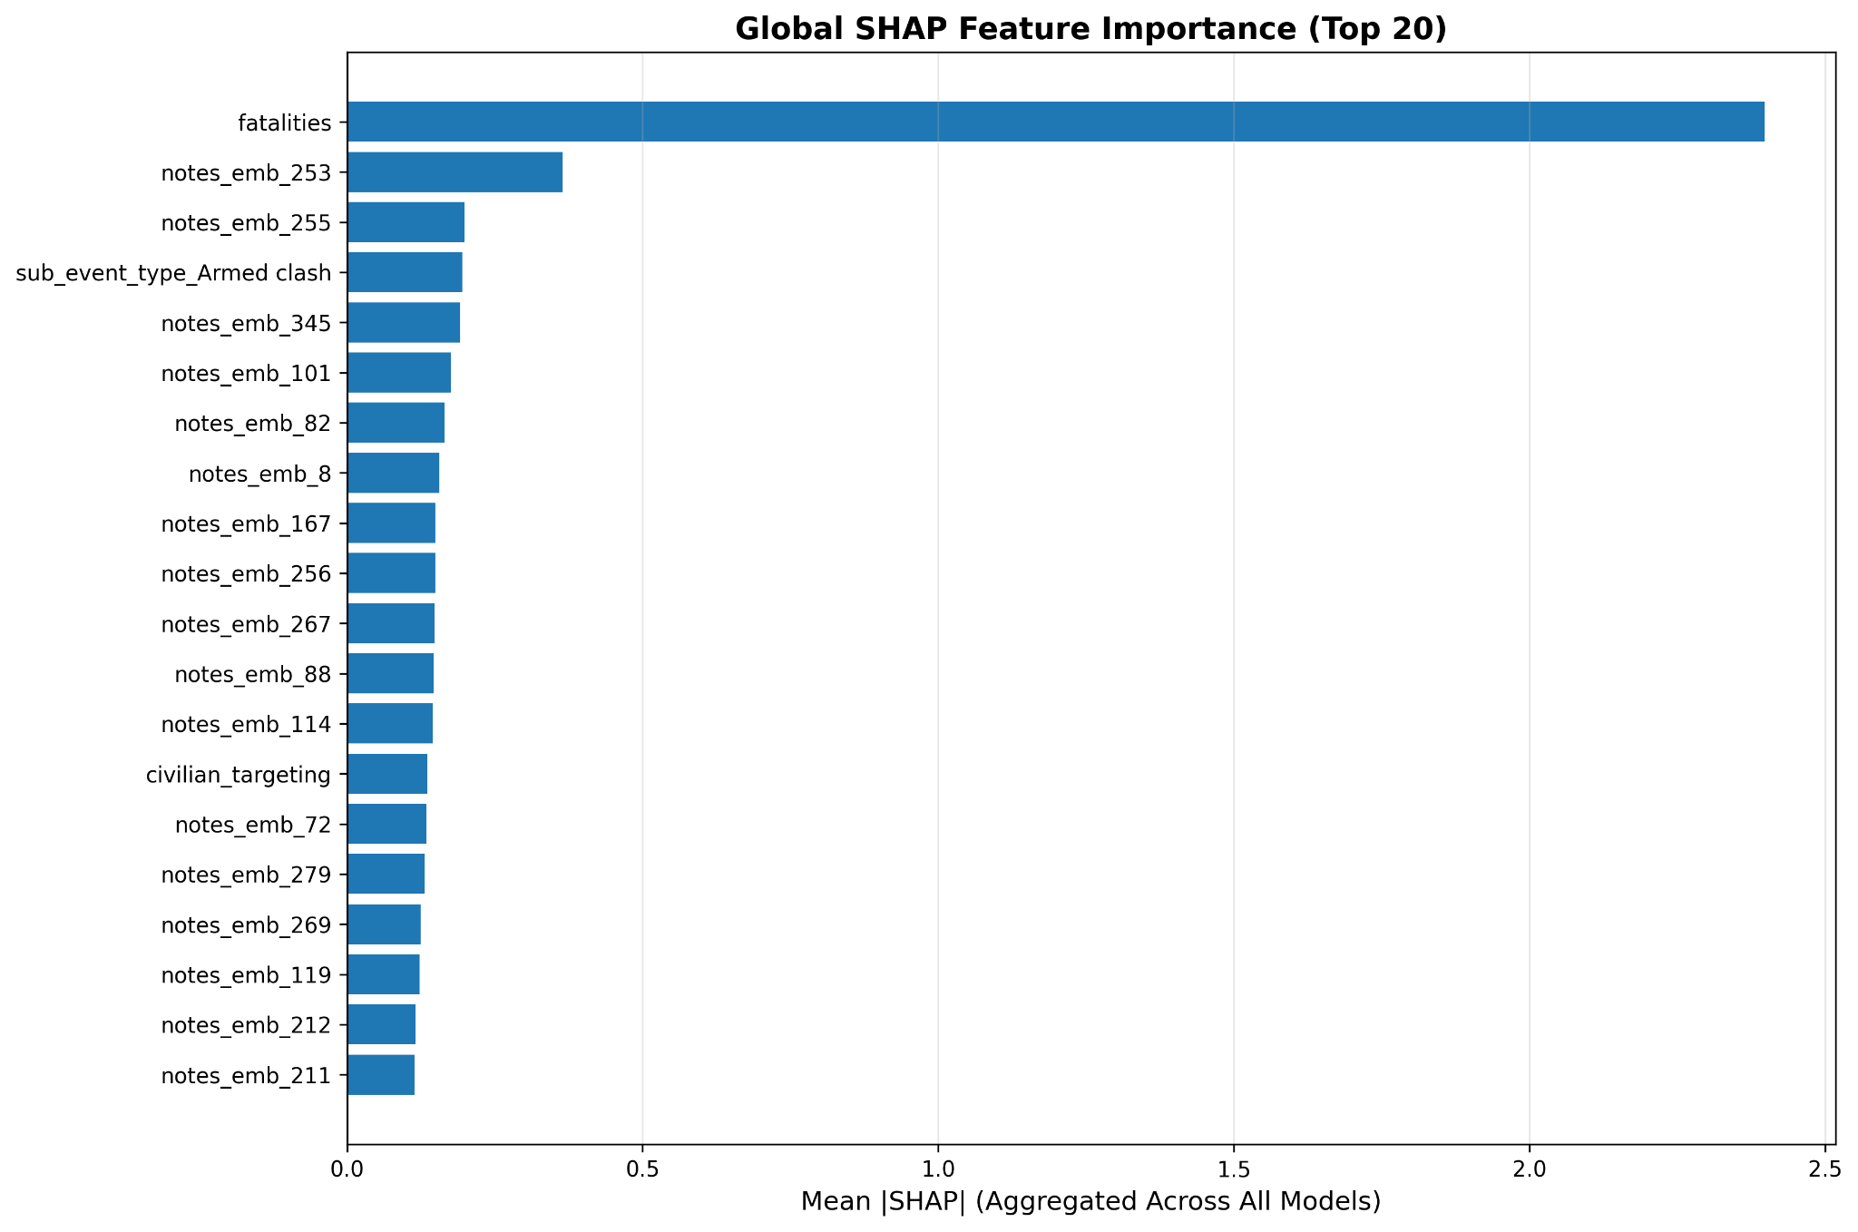
XAI: Classical

Slide 16
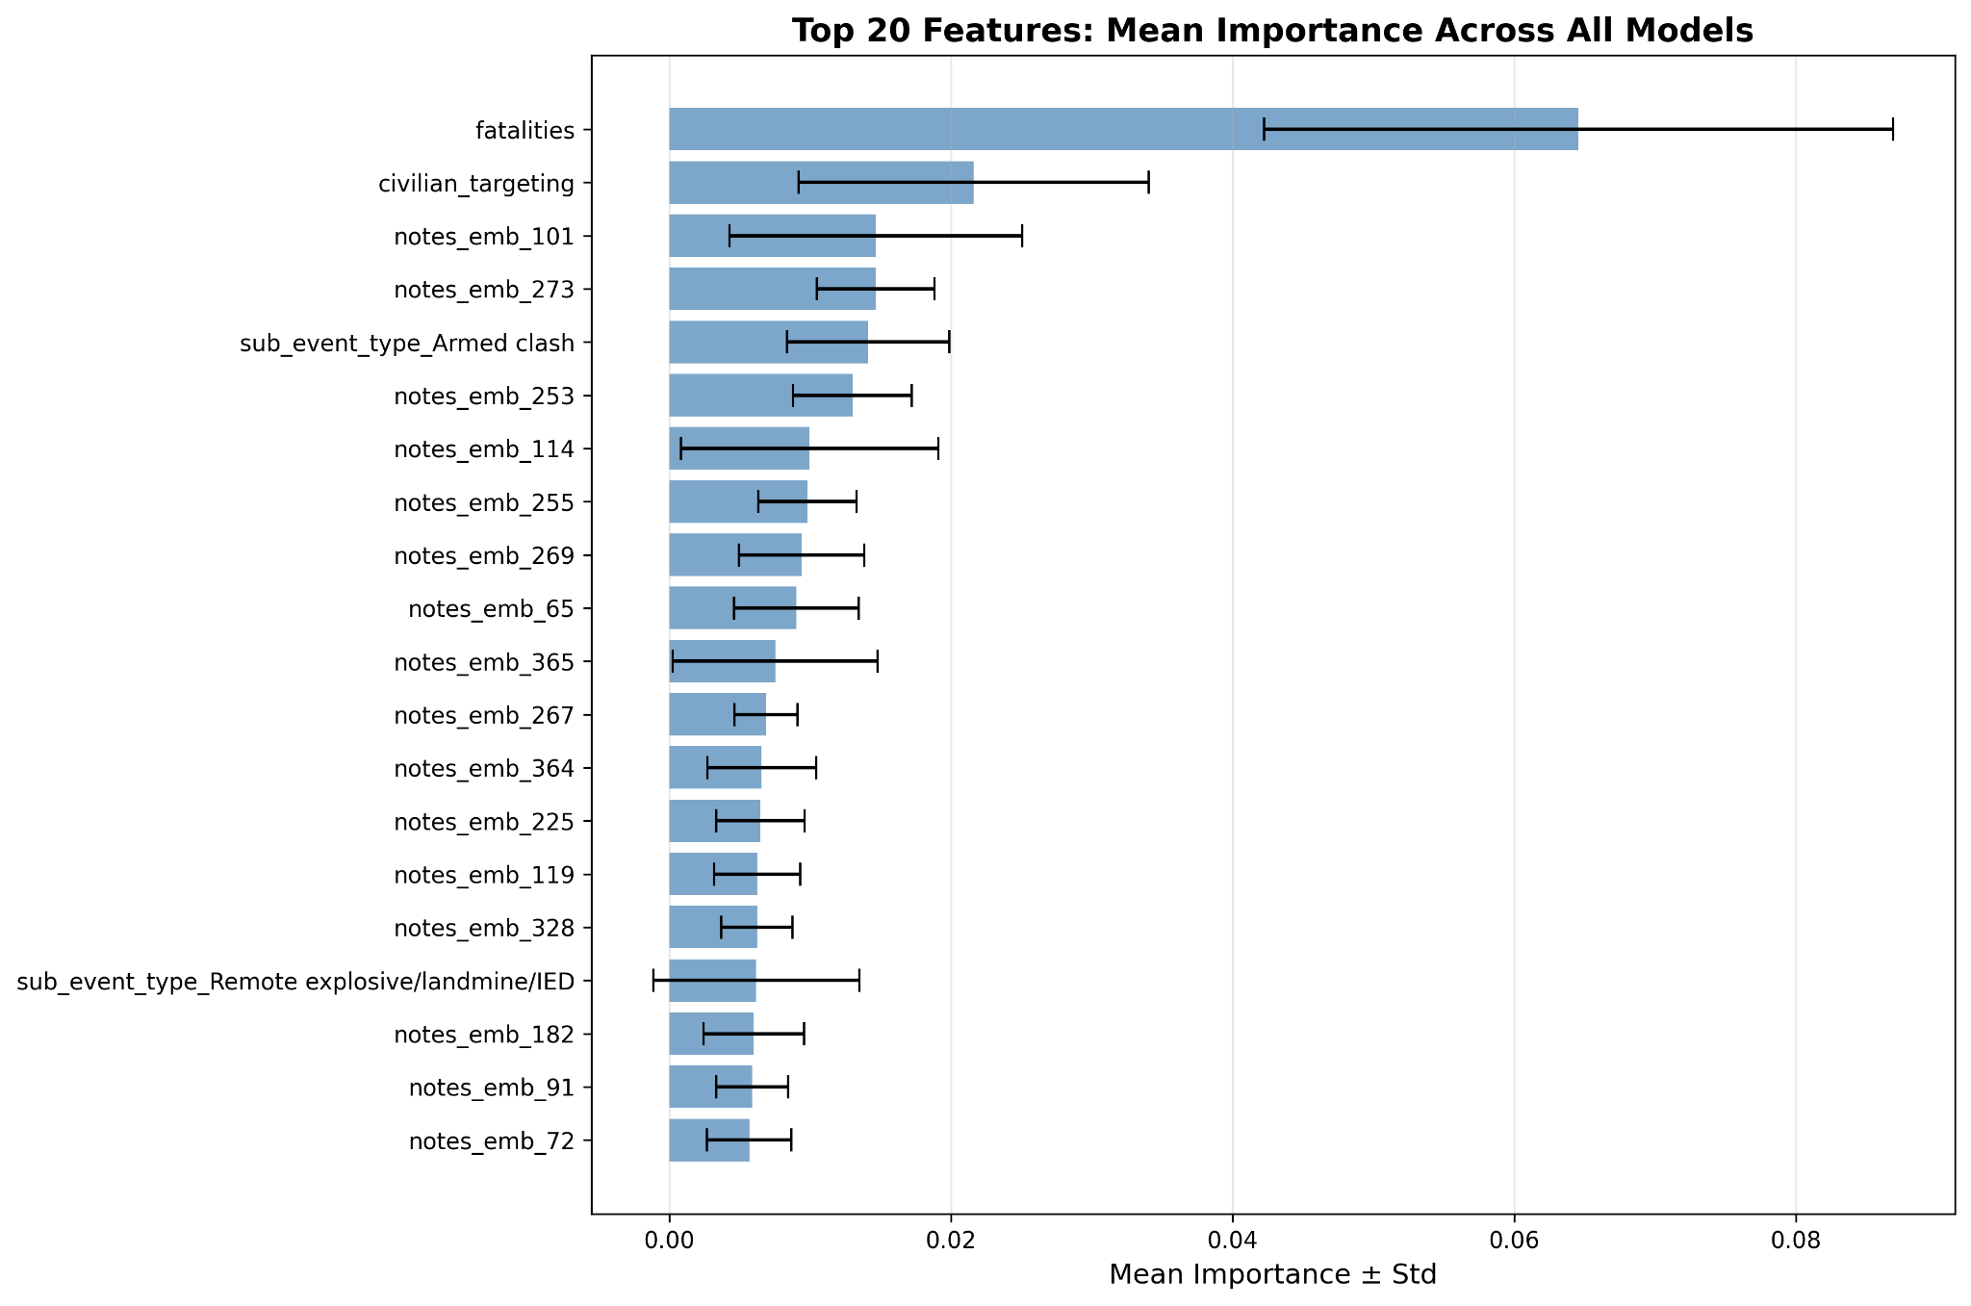
XAI: Classical

Slide 17
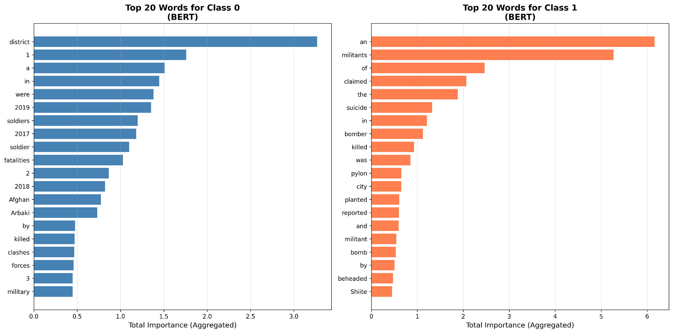
XAI: BERT

Slide 18
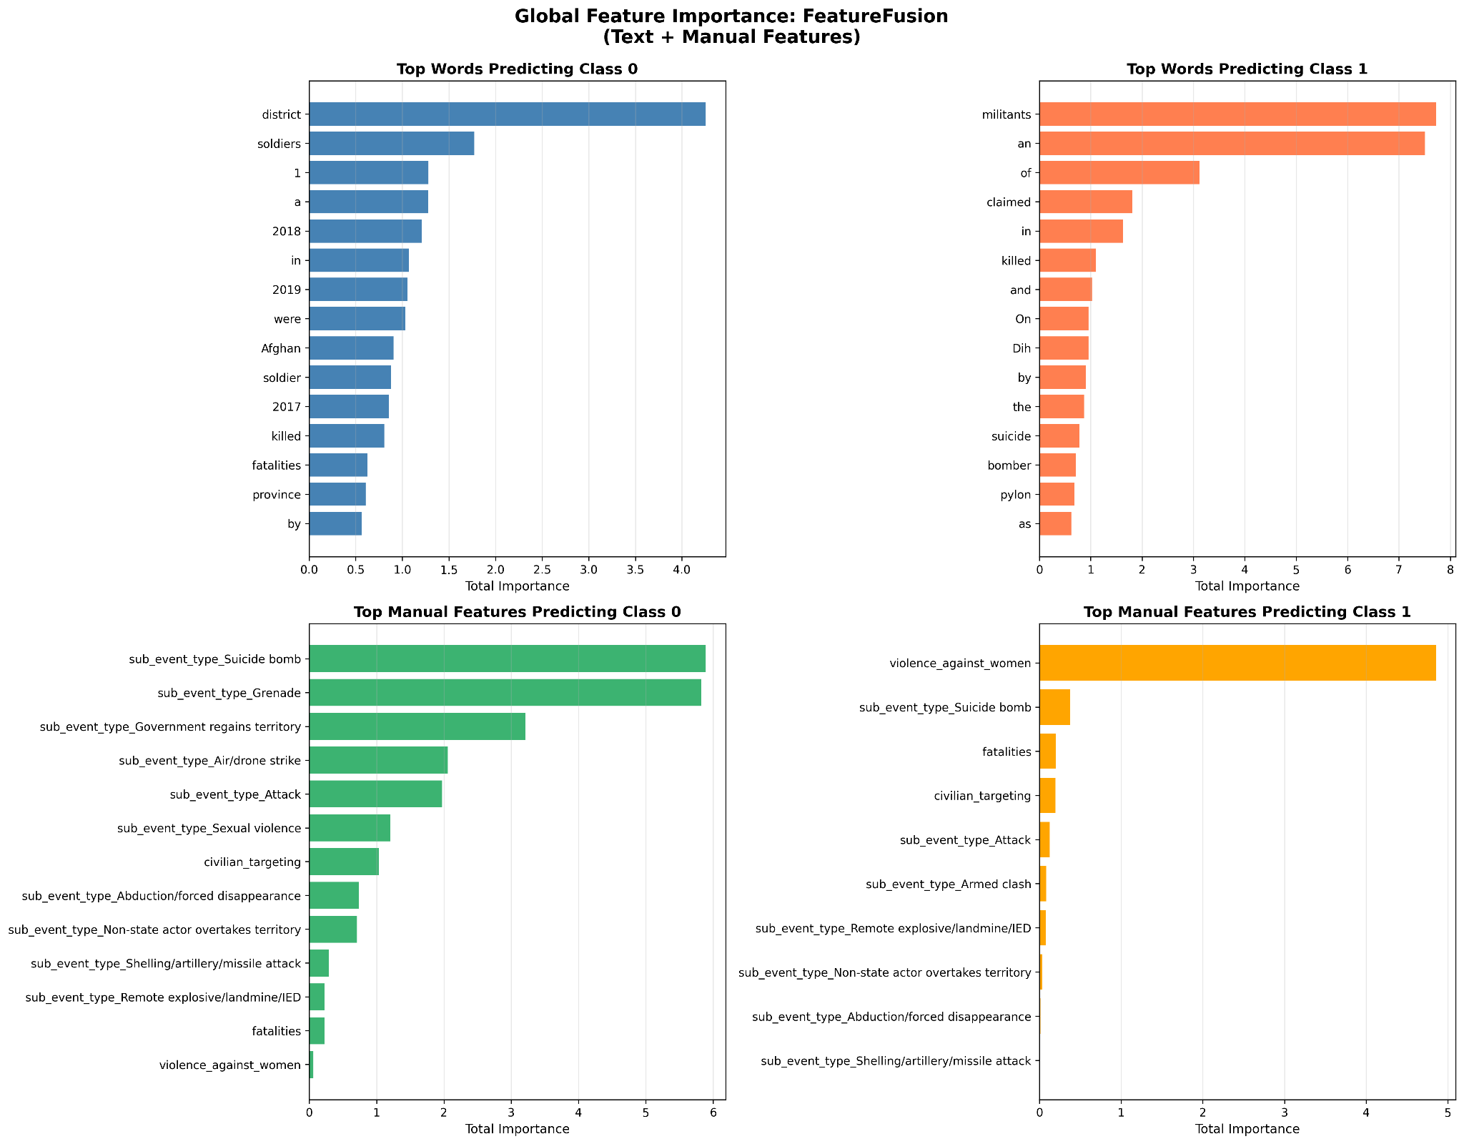
XAI: Feature Fusion

Slide 19
Conclusion

